Slide 1
Odysseus – Chapter 12

Slide 2
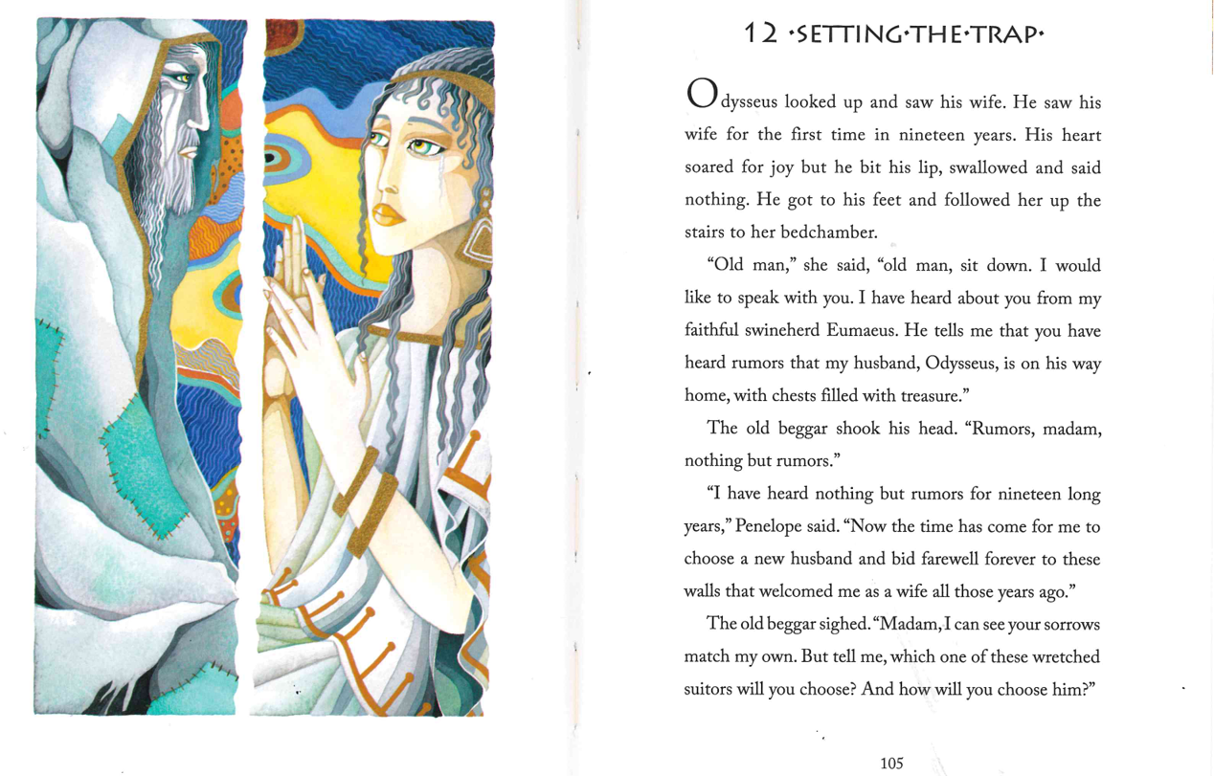

Slide 3
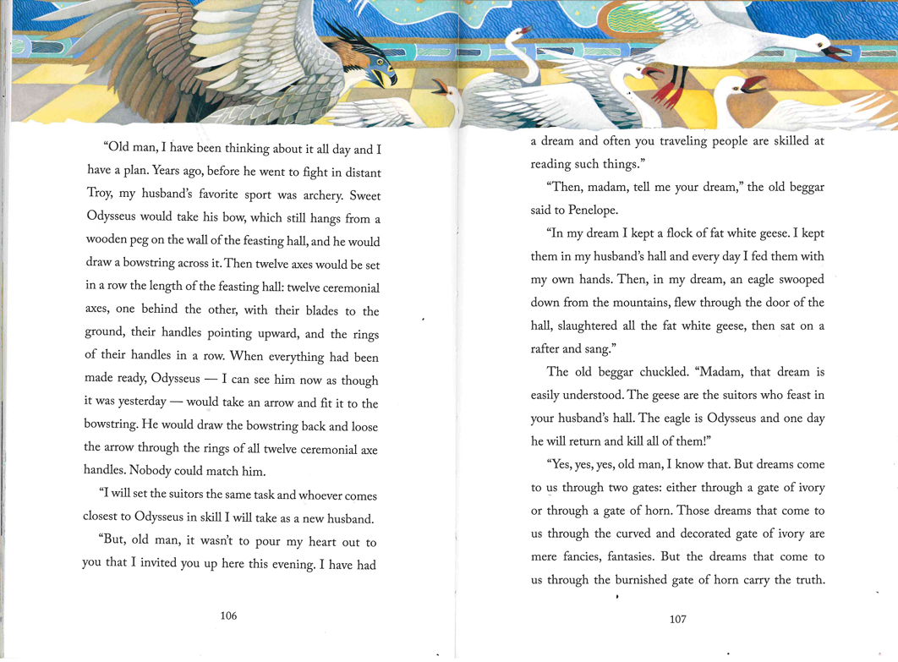

Slide 4
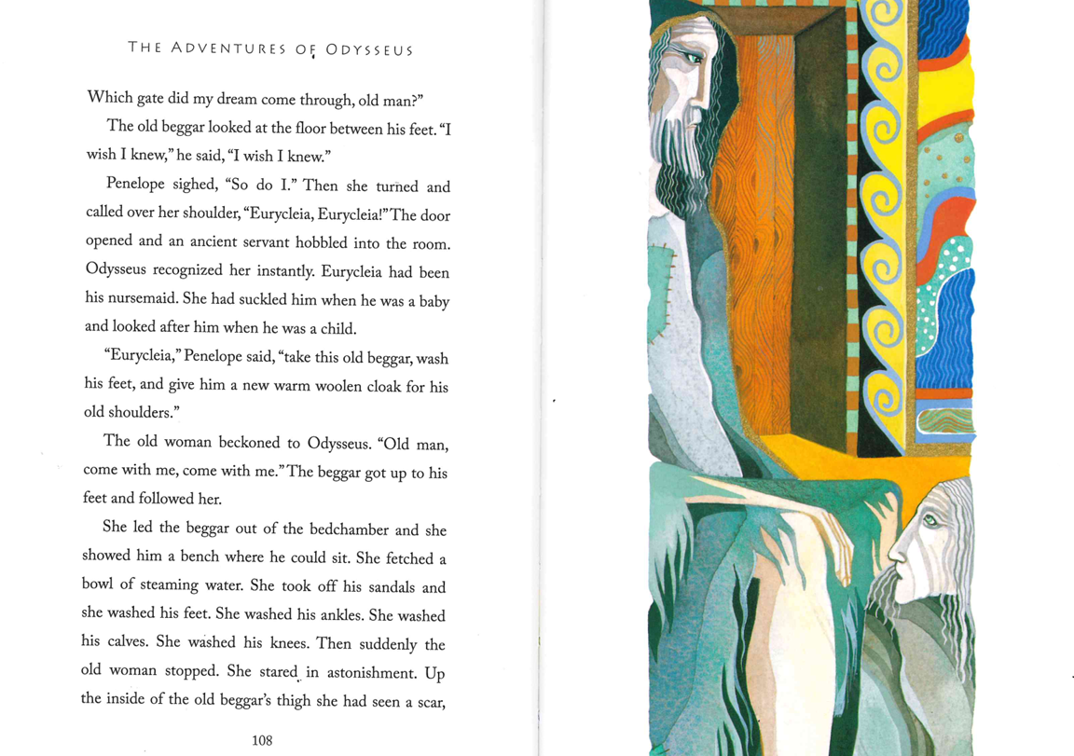

Slide 5


