Slide 1
Odysseus – Chapter 9

Slide 2
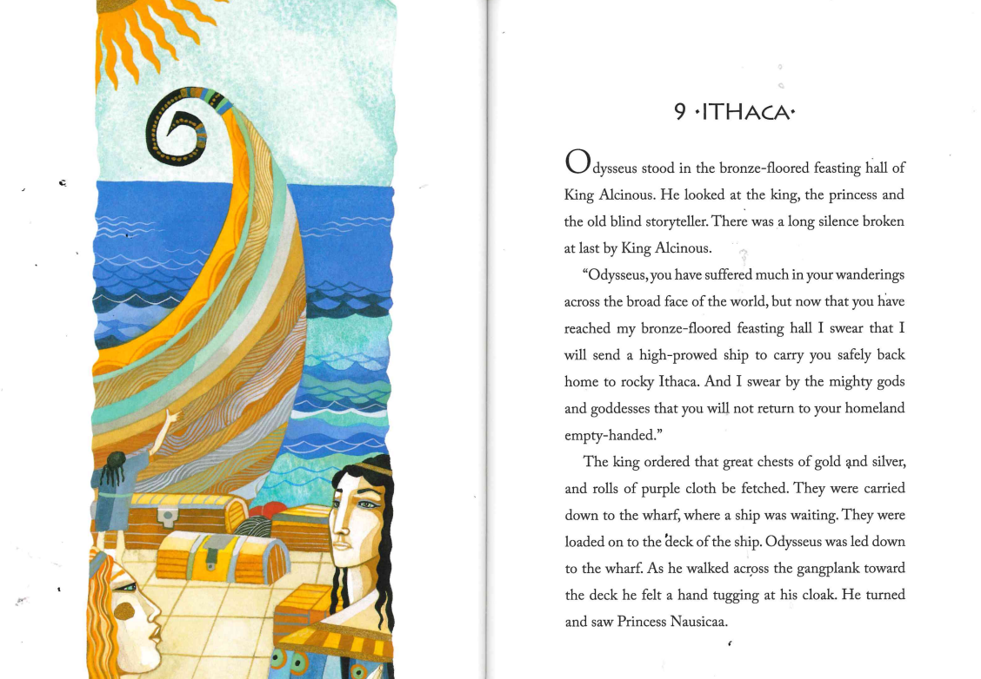

Slide 3


Slide 4


Slide 5
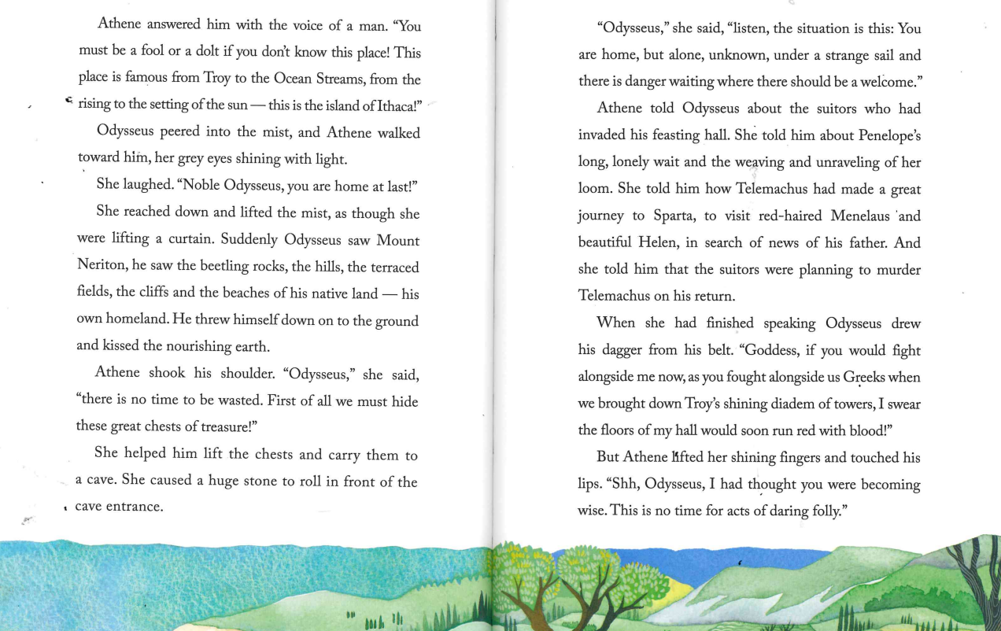

Slide 6
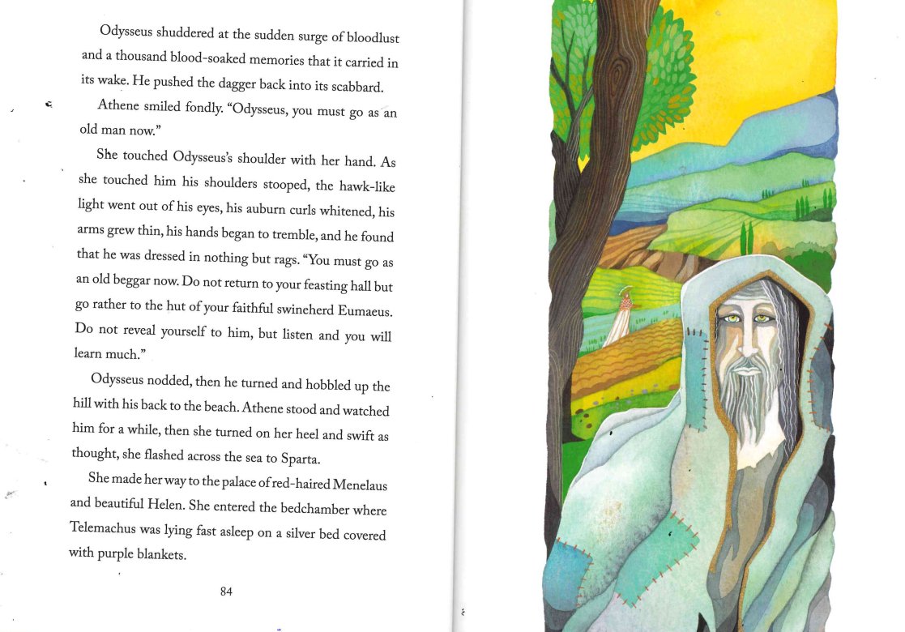

Slide 7


