Slide 1
Odeysseus – Chapter 7

Slide 2
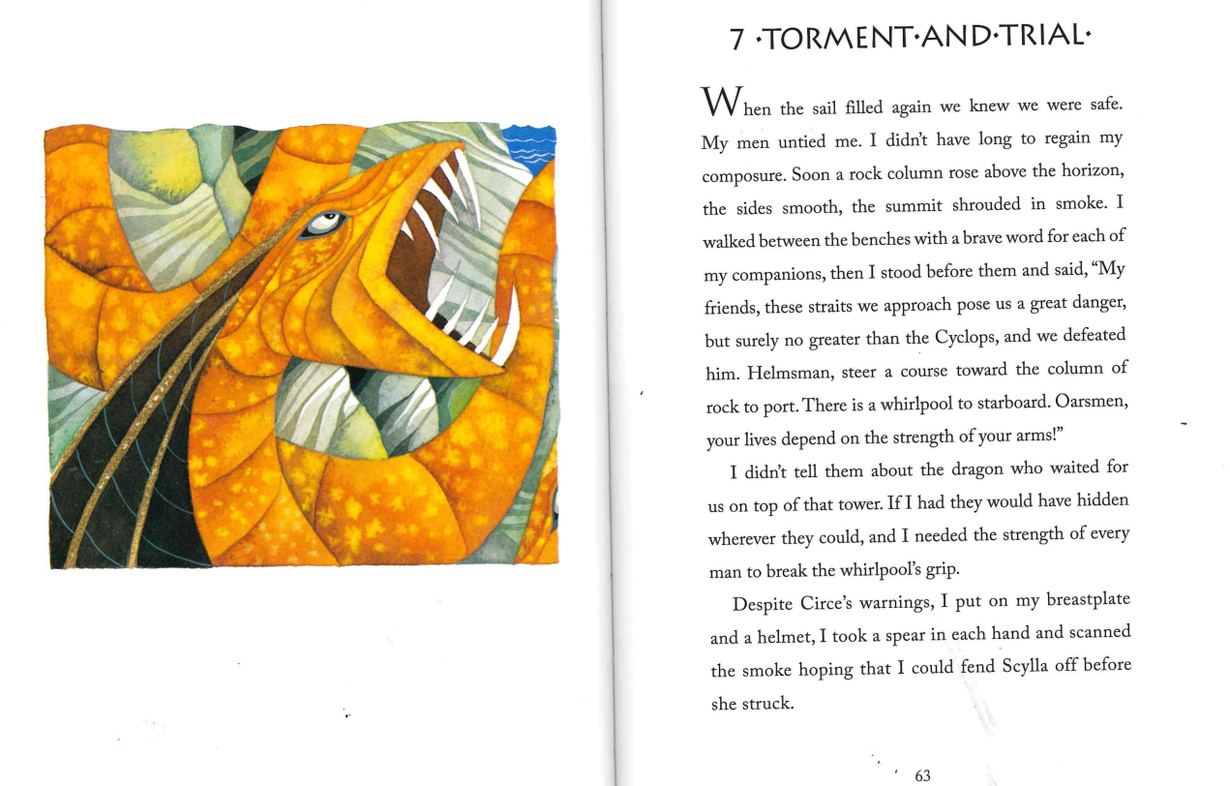

Slide 3


