Slide 1
Odysseus – Chapter 6

Slide 2
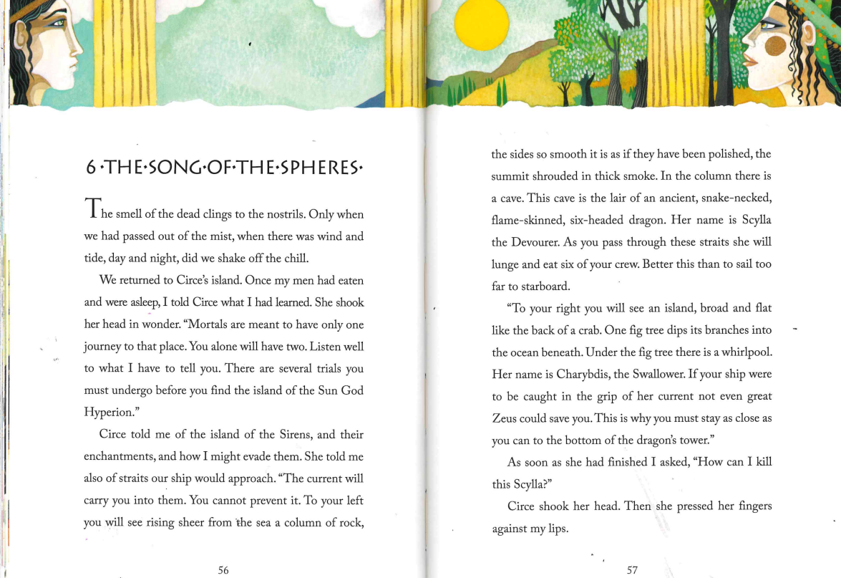

Slide 3
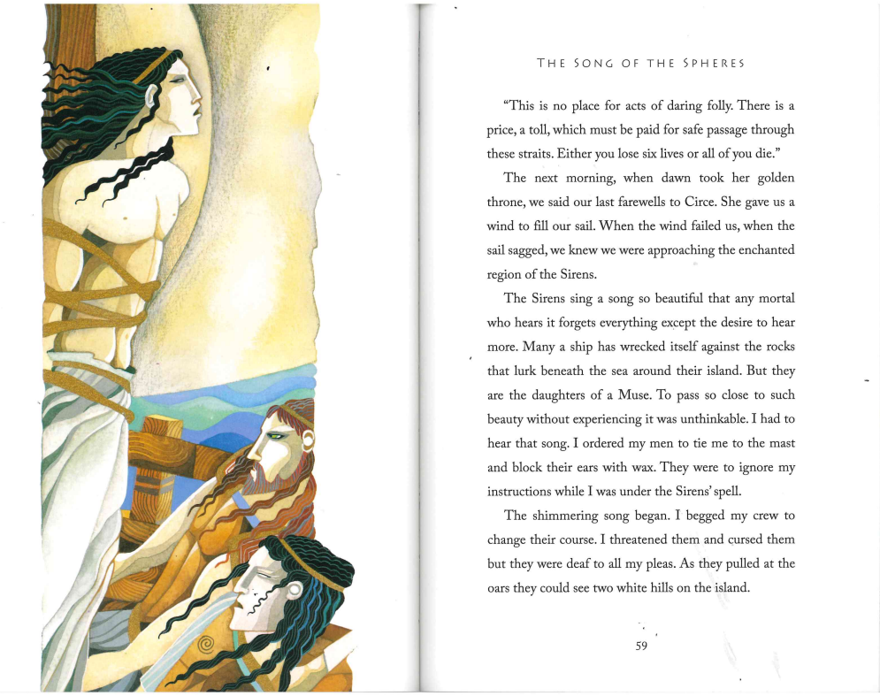

Slide 4


